Slide 1
STUDENT INFO
Name: Sangeetha M
Register No : 24131210500122039
NMID: asanm121anm12124213038
Department: BCA
College: Immaculate College for Women
University: Annamalai University

Slide 2
PROJECT TITLE
STUDENT PORTFOLIO

Slide 3
AGENDA
Problem statement
Project overview
End users
Tools and technology
Portfolio design and layouts
Features and functionalities
Results and screenshots
Conclusion
Github link

Slide 4
PROBLEM STATEMENT
In today’s competitive academic and professional environment, students face difficulties in presenting their skills, achievements, and projects in a structured way.The absence of a personalized digital platform creates challenges during:
Internship applications
Job interviews
Academic evaluations
Hence, a student portfolio website is needed to showcase their profile in a professional and accessible manner.

Slide 5
PROJECT OVERVIEW
The project aims to create a responsive student portfolio website that highlights:
Personal details (basic information, bio, contact)
Education qualifications
Technical and professional skills
Projects and achievements
The website is designed with HTML, CSS, and JavaScript, focusing on: Clean and attractive design, Mobile and desktop responsiveness, Easy navigation and user-friendliness

Slide 6
END USERS
1. Students – To present their profile in an organized way.
2. Recruiters/Employers – To assess student capabilities during hiring.
3. Academic Institutions – To review student achievements and records.

Slide 7
TOOLS AND TECHNOLOGIES
Frontend Technologies: HTML, CSS, JavaScript Editor: codepen Version Control: GitHub Other Tools: Browser Developer Tools for testing

Slide 8
PORTFOLIO DESIGN AND LAYOUT
The portfolio follows a section-based layout:
Home / Introduction – Student name, photo, and quick introduction.
About Me – Short biography and interests.
Education – Academic background and qualifications.
Skills – List of technical and soft skills.
Projects – Details of major academic or personal projects.
Contact – Email, social links, and contact form.

Slide 9
FEATURES AND FUNCTIONALITY
Responsive design compatible with desktop and mobile. Easy-to-read sections with smooth navigation. Resume download option. Contact form for quick communication. Simple, elegant design that focuses on clarity.

Slide 10
RESULTS AND SCREENSHOTS
Successfully developed a student portfolio website that is professional, clean, and responsive. The platform makes it easy for students to showcase their achievements and skills to recruiters and academic evaluators.

Slide 11
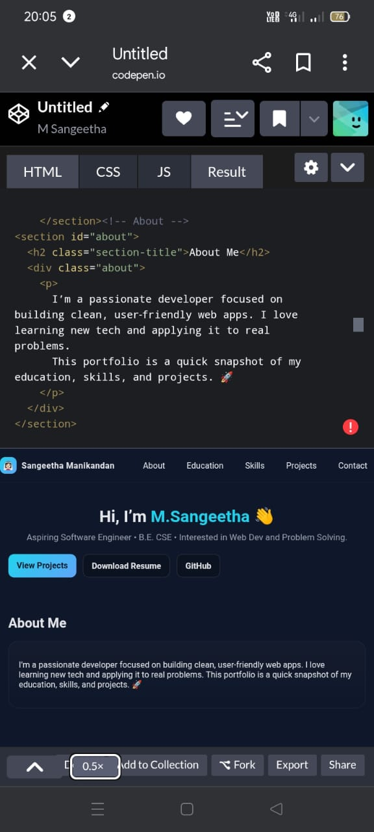
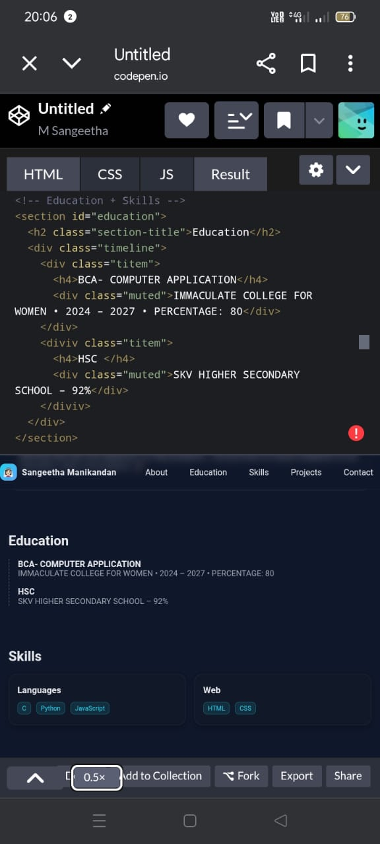
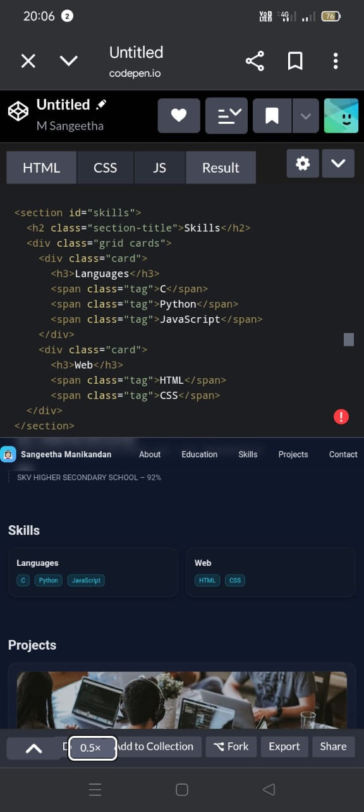
RESULTS AND SCREENSHOTS

Slide 12
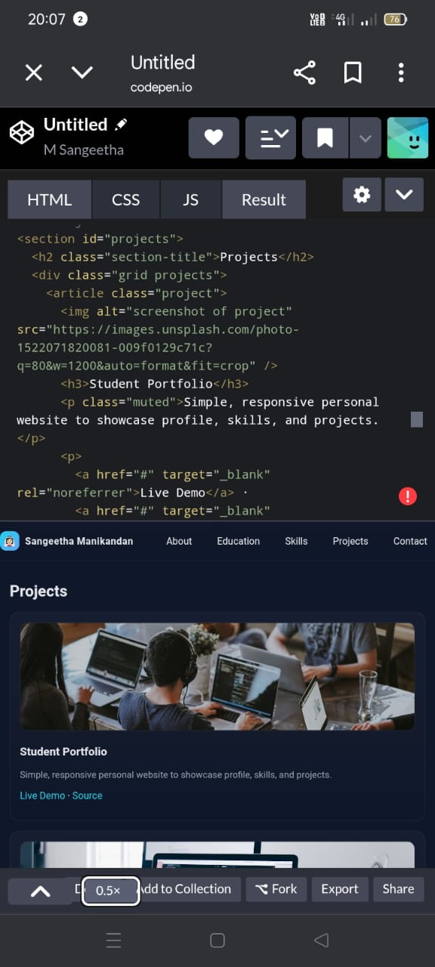
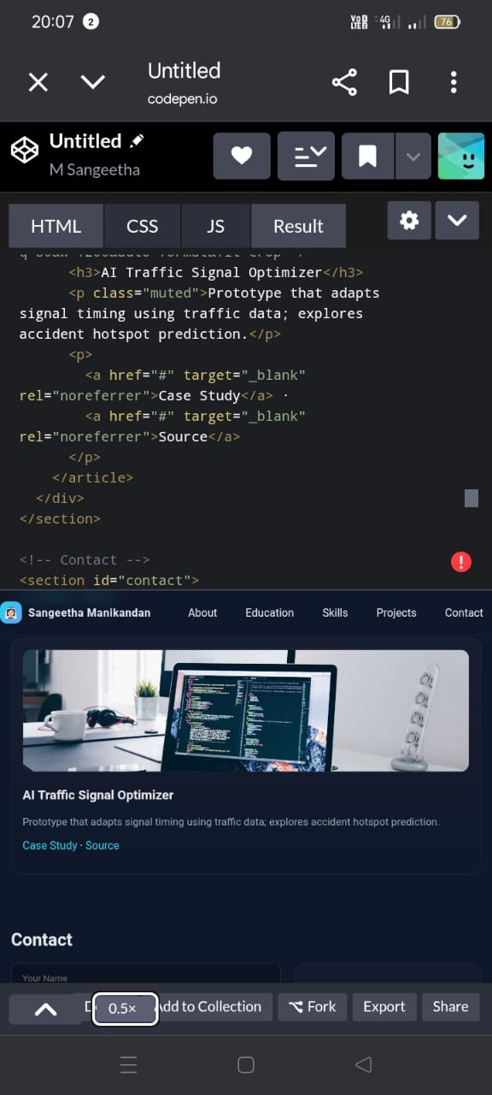
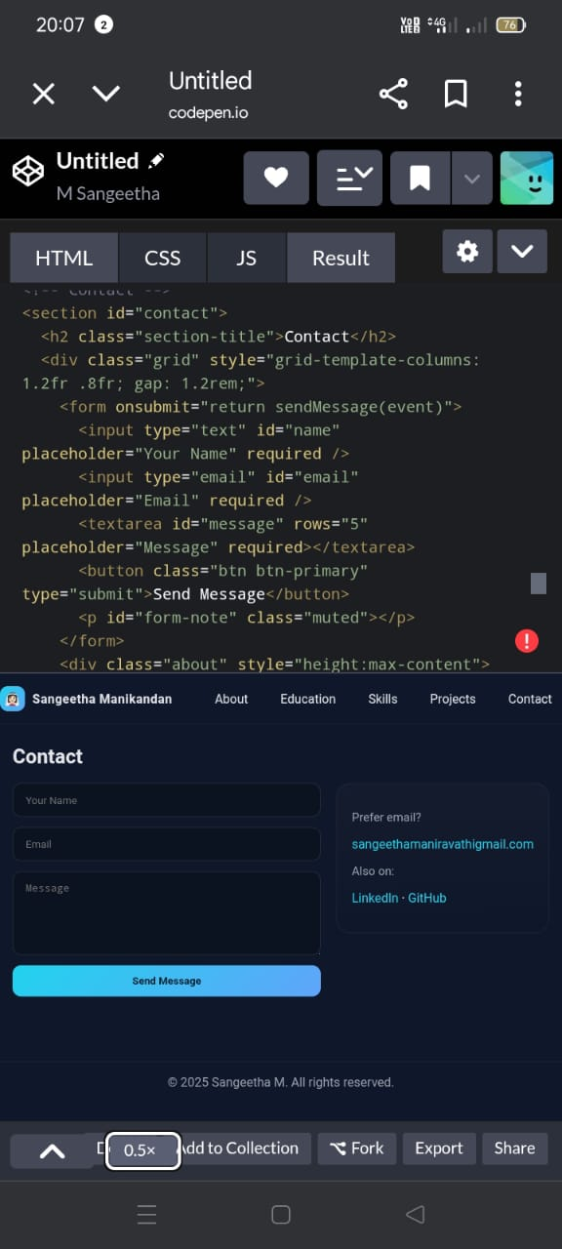
RESULT AND SCREENSHOTS

Slide 13
CONCLUSION
The Student Portfolio Website acts as an effective digital platform for students to present themselves in the best possible way. It bridges the gap between students and recruiters by providing a personalized, accessible, and professional online profile. This enhances opportunities in internships, job placements, and academic growth.

Slide 14
GITHUB LINK
Sangeetha--TNSDC-SWD-DP

